Slide 1
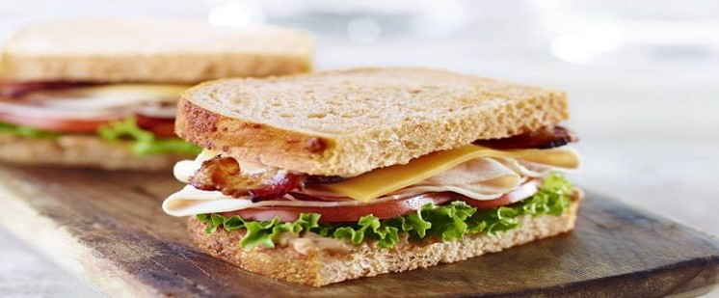
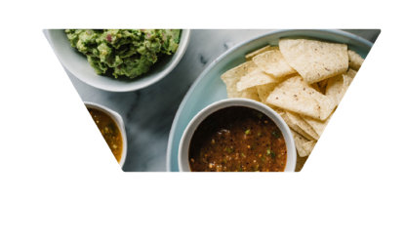

Slide 3
AGENDA
Header
Body copy
  • XXXX
  • XXXX
  • XXXX
  • XXXX
  • XXXX
  • XXXX
3

Slide 4
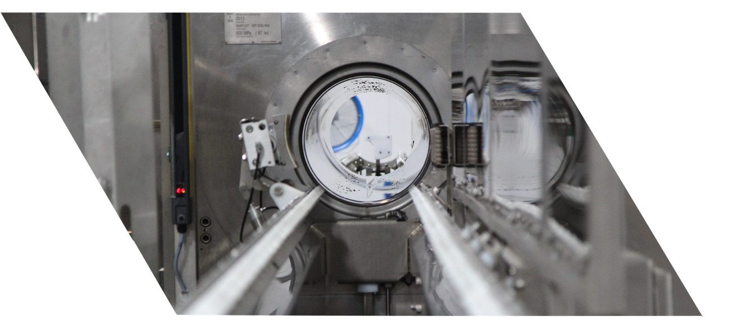
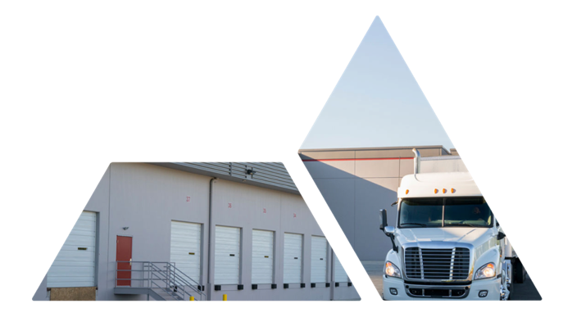
UNIVERSAL PURE OVERVIEW

Slide 5




Company history
Headquartered in Villa Rica, GA, Universal Pasteurization and Cold Storage Company LLC is dedicated to ensuring the safety and quality of foods and beverages.
As a customer-centric service provider of high pressure processing (HPP), Universal’s four U.S. locations and 11 HPP machines in operation make it the largest service provider of HPP services globally. Companies also outsource with Universal for Cold Storage and related value-added services
(kitting, pre-pricing, code dating, inventory control), and to leverage their technical, quality assurance, engineering and cold-chain expert resources in order to bring fresh, natural, organic and cleaner-label products to market.
We are grateful for the role we play and we are focused on continually improving by investing in our people, facilities, technology and services to support food safety and quality requirements and initiatives in the food and beverage industries.
Universal installs first HPP machine
Universal Pasteurization
is founded
2010
Universal acquires HPP business in Coppell, Texas
Universal opens
third branch
2014
Universal becomes Universal Pure
Universal
operates 11 HPP machines today
2017
2001
Universal is founded as Universal Cold Storage
2013
Universal opens a new HPP facility in Villa Rica, Georgia
2015
Universal opens
its fourth facility
in Malvern, Pennsylvania
5

Slide 6

AT A GLANCE
Industry Leader | Sole focus on providing safe and healthy food solutions Founded in 2010 Industry leading engineering expertise Most highly certified company in the industry Founding member of the HPP Summit
Largest Facility Network | Four strategically located facilities Additional facilities being added Full back-up systems at each facility for your extra protection, ensuring no order disruptions or delays
Track Record | Marquis food manufacturers, retailers and food service companies trust us and rely on us to protect their customers and their reputations We keep our promises - from on-time delivery to specification conformance – so you can keep yours
Innovation Partner | In-house expertise to assist with formulations, packaging and testing Partnerships with University of Nebraska Food Processing Center, Cornell and University of Georgia provide applied research, pilot engineering, product development, labeling and compliance services, and sensory analysis
Supply Chain Partner | The most comprehensive suite of value-added services, enabling our customers to meet their customers’ expectations and improve operational efficiency Examples include: air and water tempering, netting, kittting, reboxing, pre-pricing, ink jetting & code dating, order picking and scanning, blast and static freezing, etc.
6

Slide 7
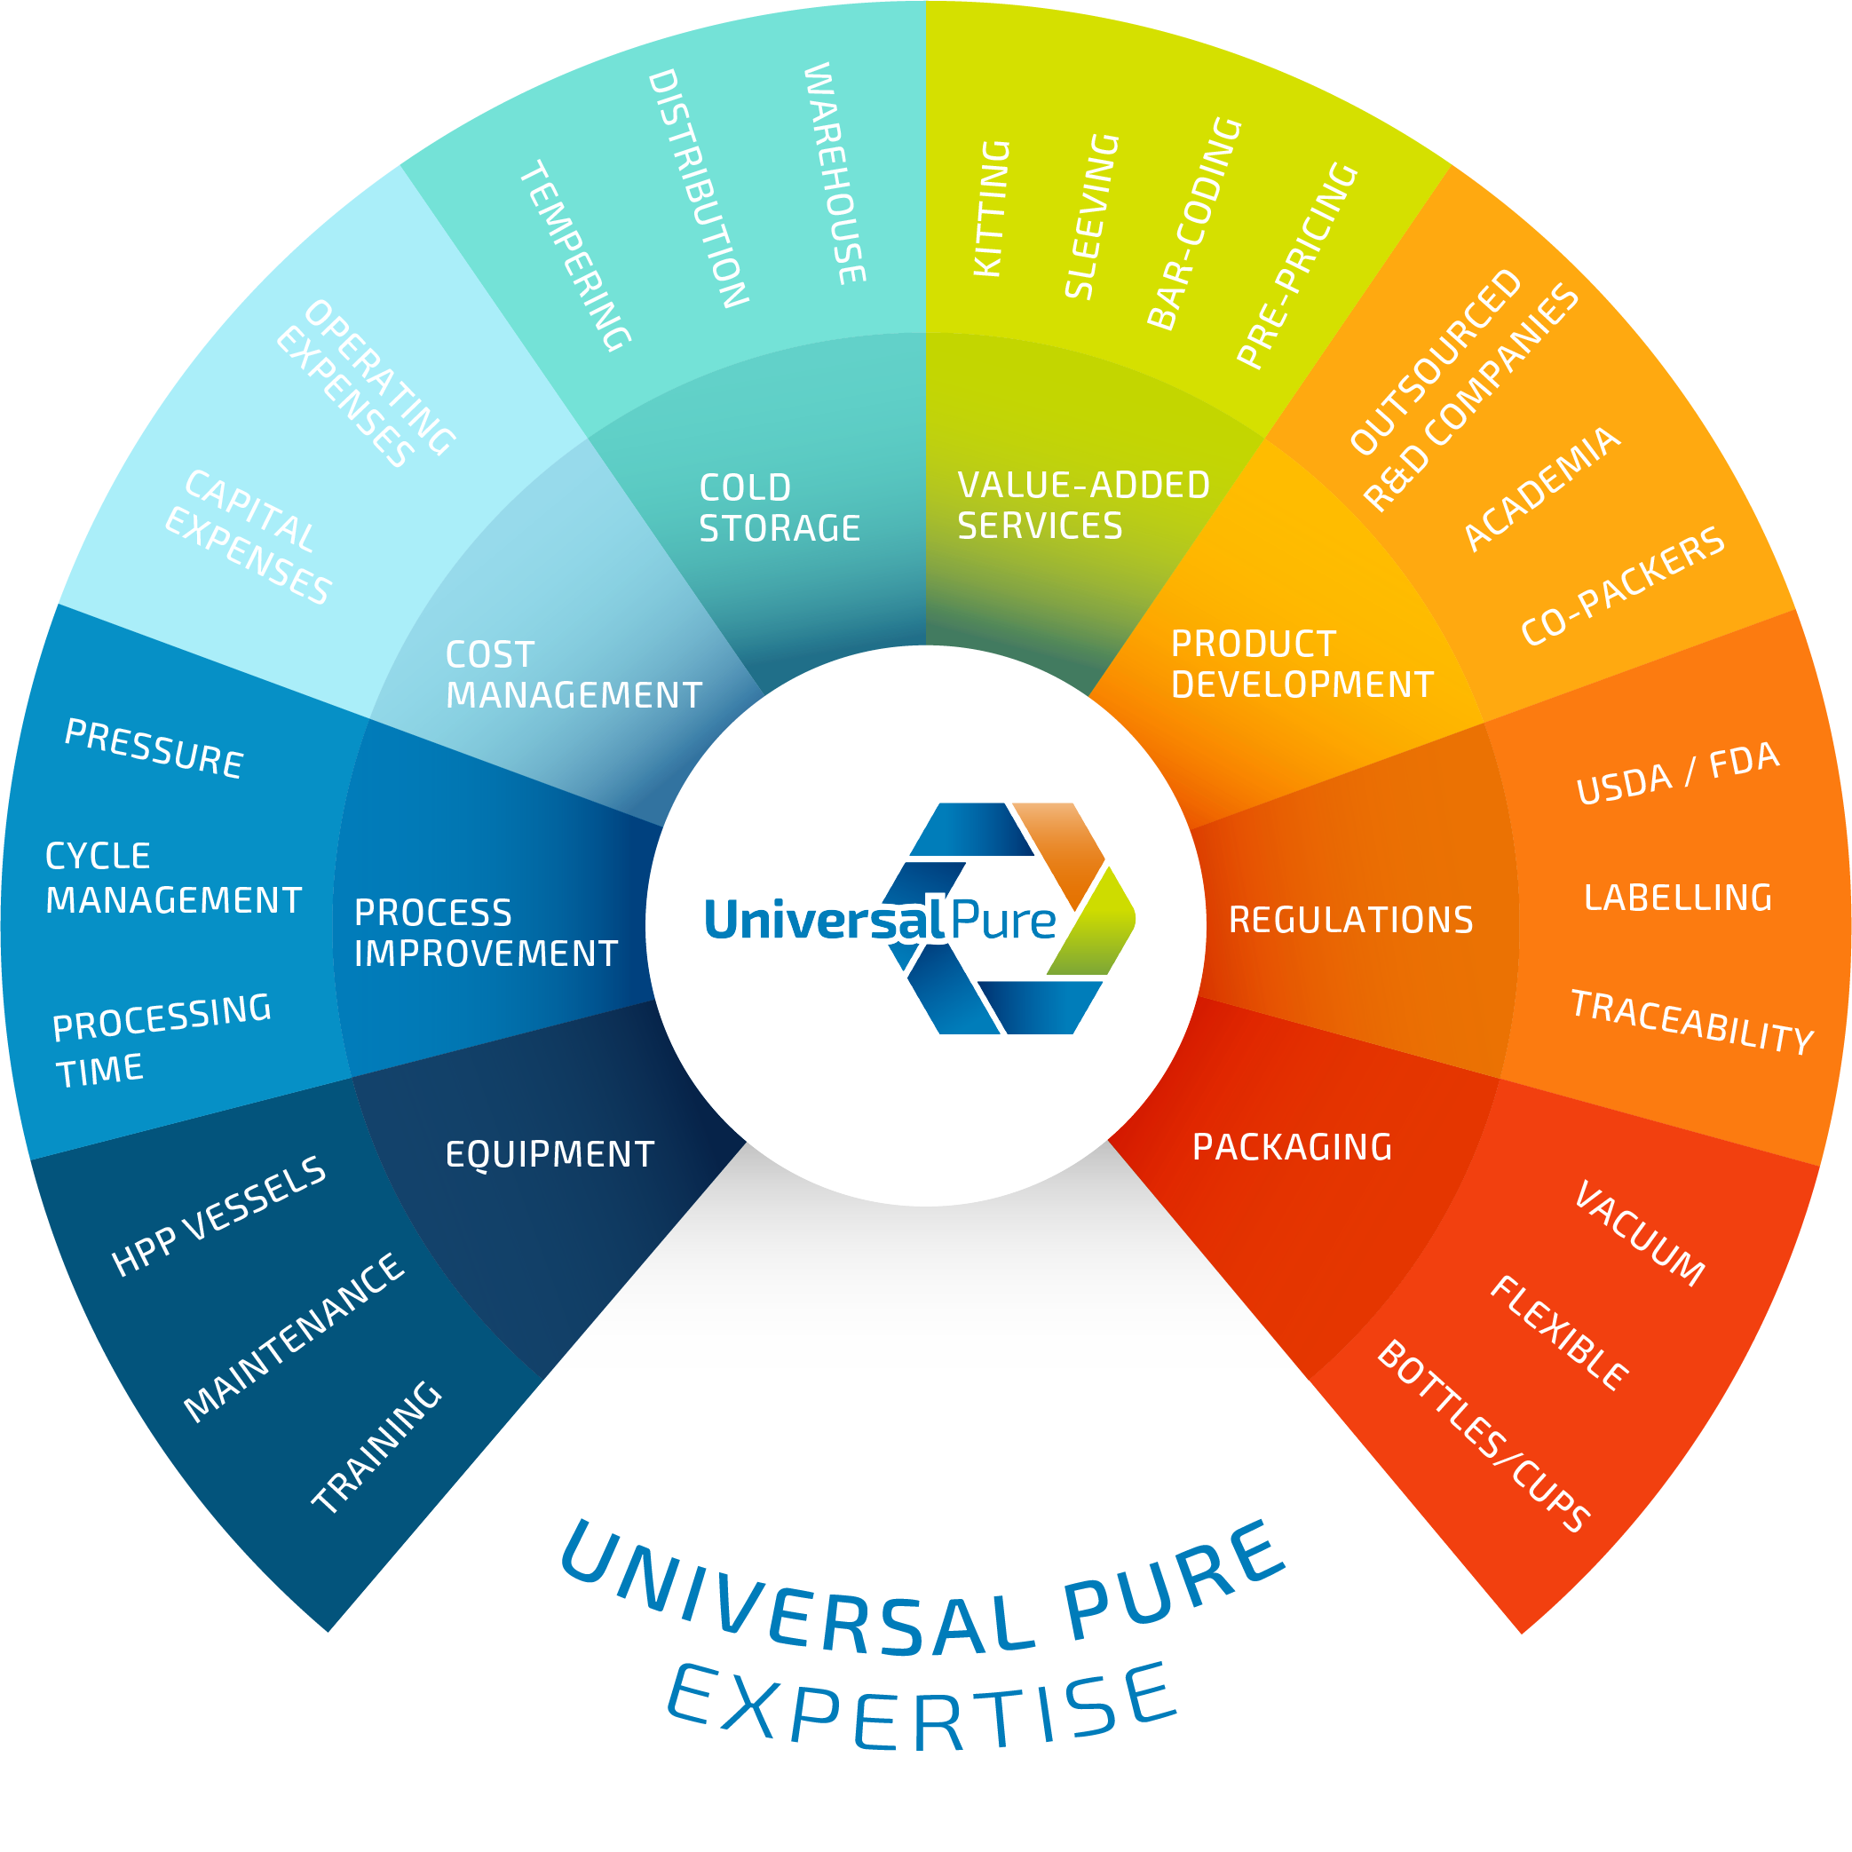








EXPERTISE
Universal Pure can work with your current suppliers or bring our relationships to help you innovate and deliver the best products to your customers – we are your solutions provider
PACKAGING
REGULATIONS
PRODUCT DEVELOPMENT
VALUE-ADDED SERVICES
COLD STORAGE
COST MANAGEMENT
PROCESS IMPROVEMENT
EQUIPMENT
7

Slide 8






capabilities
  Full Service Solution for Customers
  Cold Storage
  Cost Management
  Kitting
  Packaging
  HPP
  Pre-HPP and Post-HPP Services
  Product Development
  Regulations
  Testing
  Food Safety & Quality Commitment
  SQF Level III
  FDA Approved
  USDA Inspected
  Certified Organic
  Kosher
8

Slide 9

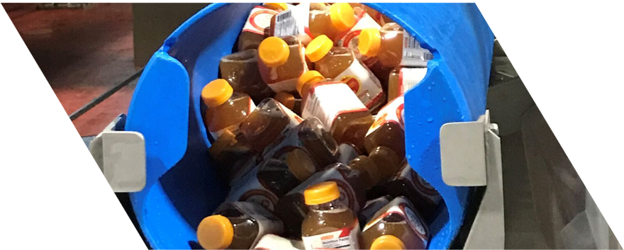

SERVICES
Pre-HPP Services
• Cold Storage
• Air Tempering Water
• Tempering Blast Freezing
• Static Freezing
• Dry Aging
High Pressure Processing
Post-HPP Services
• Kitting
• Assembly
• Labeling
• Netting
• Code Dating
• Ink Jetting
• Order Selection
• Export / Shipping
9

Slide 10
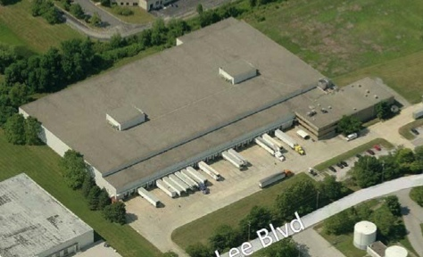
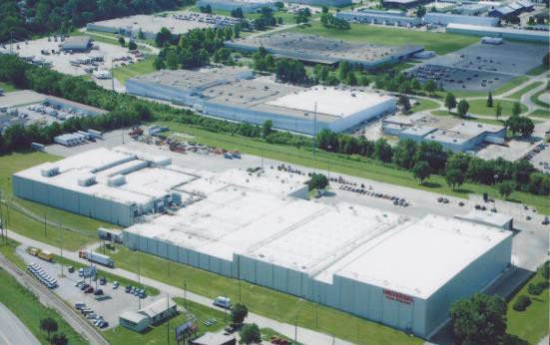

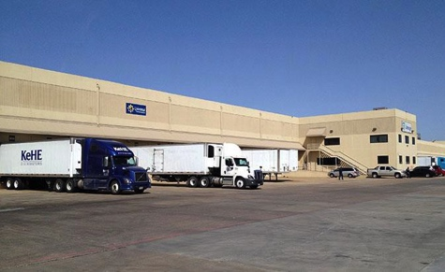
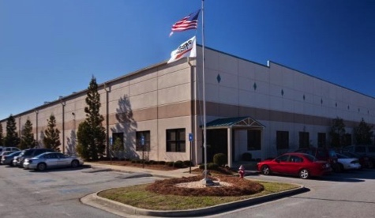
LOCATIONS
Malvern, PA
Universal’s 4th facility opened in
July 2015
Two 525L HPP presses
90,000 Sq. ft. facility
2,500 refrigerated pallet positions
Located 30 miles north of Philadelphia
Lincoln, NE
Universal operates two facilities in
Lincoln, Nebraska
HPP Toll Processing, Cold Storage, Value-Added Services
Four 350L HPP presses
670,000 sq. ft. of space on 42 acres
Full Time USDA Inspection (Plant # 31896 & 31896P)
610, S.F. Chilled or Frozen
Four USDA Production/Processing Rooms
Air & Water Tempering Services
88 Dock Doors total
90 Forklifts/Pallet movers to handle product
OSSID weigh-price-labelers for code dating and pre-pricing
Coppel, TX
Villa Rica, GA
Universal acquired a HPP toll processor in 2014, establishing its HPP footprint in the Dallas/
Ft. Worth metro area
Two 350L HPP presses
24,000 sq. ft. facility
Only HPP facility in the Southwest U.S.
Currently HPP’ing RTE/RTC meat and premium juices
Universal opened a dedicated HPP facility in suburban Atlanta in 2013
Three 350L HPP presses
90,000 sq. ft. facility
Strategically located in close proximity to tier-1 poultry manufacturers
Currently HPP’s RTE/RTC
meats, Seafood, Dips and premium juices
400-mile
radius
10

Slide 11


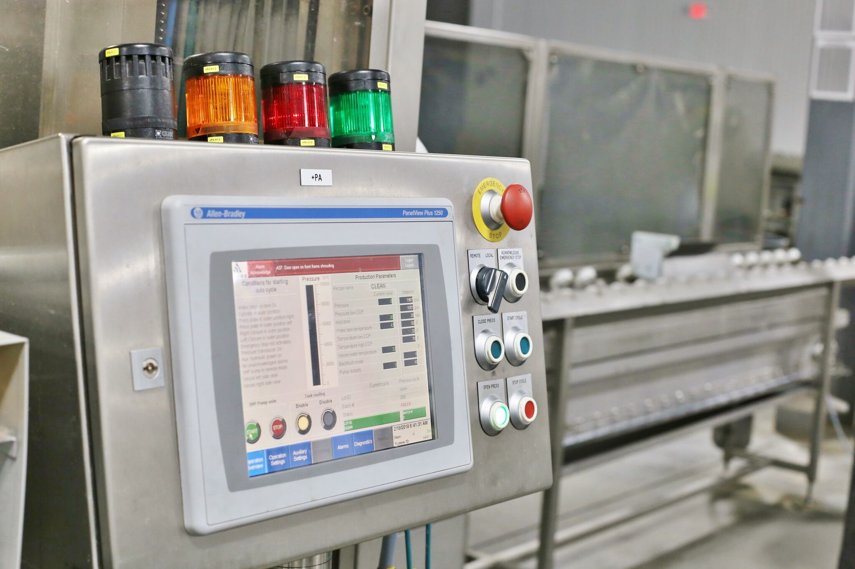
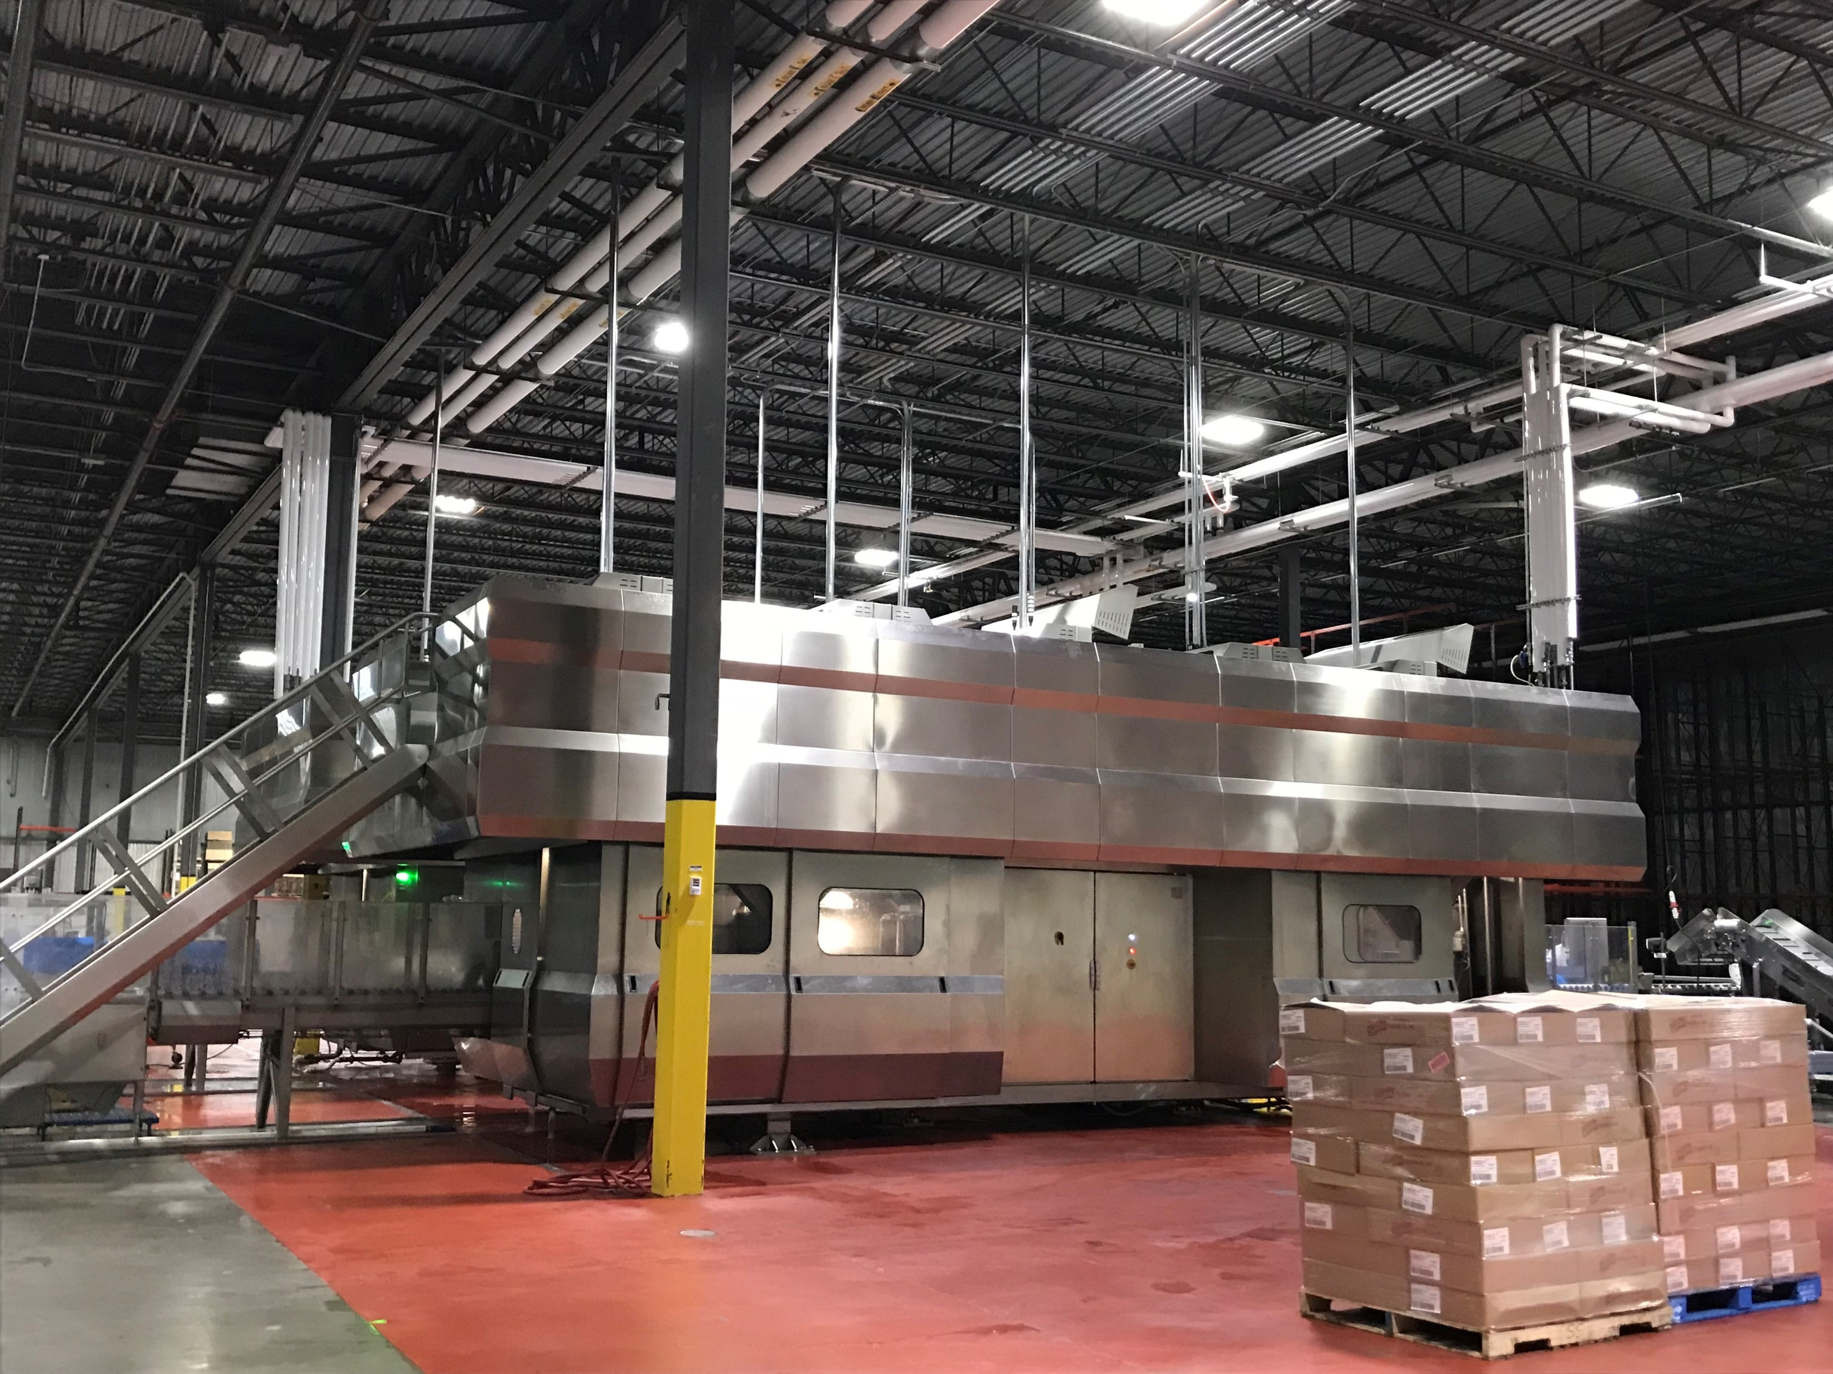
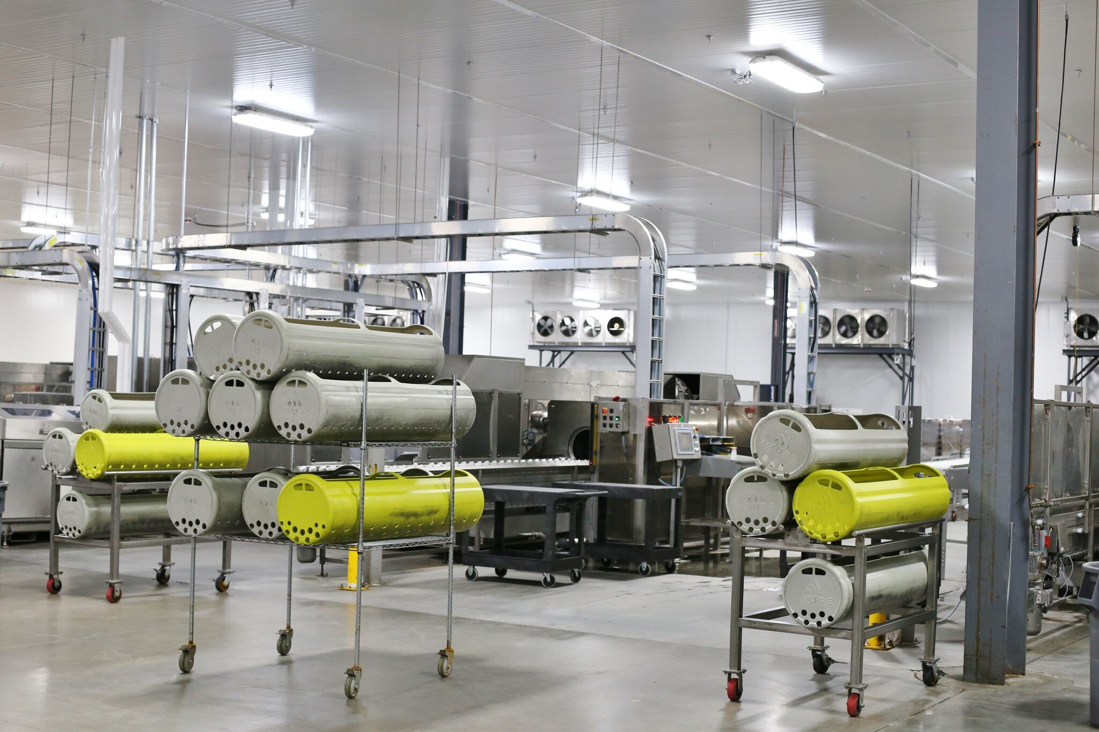
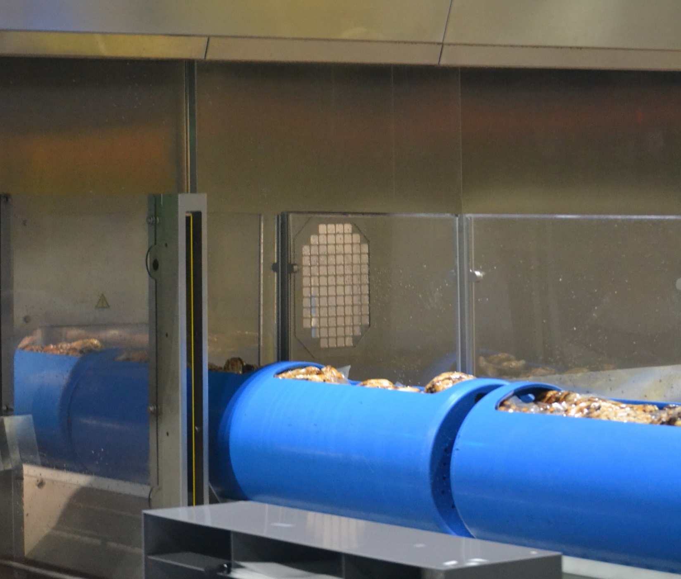
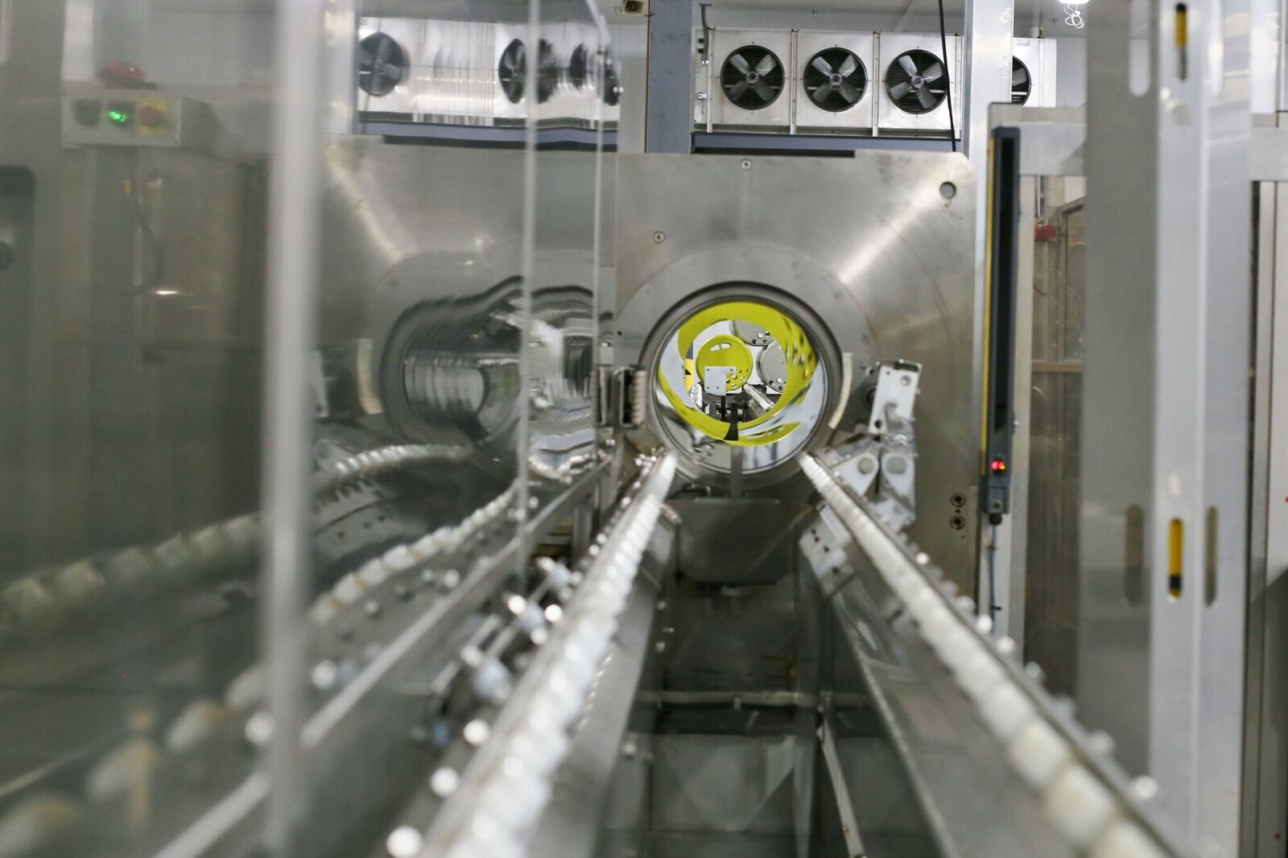
Universal pure facilities at a glance
Malvern, PA
Universal Pure’s 4th facility opened in July 2015
Two 525L HPP presses
170,000 Sq. ft. facility
2,500 refrigerated pallet positions
High Pressure Processing and value-added services
Lincoln, NE
400-mile
radius
Universal Pure operates two facilities in Lincoln, Nebraska
High Pressure Processing, Cold Storage and value-added services
Four 350L HPP presses
670,000 sq. ft. of space on 42 acres
Full time USDA inspection
Four USDA production/processing rooms
Air & water tempering services
88 dock doors & XX pallet positions
OSSID weigh-price-labelers for code dating and pre-pricing
Coppell, TX
Villa Rica, GA
Universal Pure acquired a HPP service provider in 2014
Two 350L HPP presses
24,000 sq. ft. facility
HPP toll processing and value-added services
Universal Pure opened a dedicated HPP facility in 2013
Three 350L HPP presses
90,000 sq. ft. facility
High Pressure Processing and value-added services
11

Slide 12
facilities
Capacity 60MM lbs
Geographical Reach
Lincoln, NE
Malvern, PA
  With four strategically placed facilities, Universal Pure is able to serve a majority of the U.S. population
Capacity 72MM lbs
  Largest provider of HPP services in North America
  Largest provider of cold storage in the state of Nebraska, with ~1 million ft² of cold storage space
Villa Rica, GA
400-mile radius
Capacity 36MM lbs
Capacity 54MM lbs
Coppell, TX
  Facility Highlights
  Employment: Universal Pure employs approximately 75 non-union, salaried employees and approximately 350 hourly/temp employees across all locations
  Redundancy: The company operates and services 11 HPP machines across 4 locations
  Facilities: Over 1 million square feet of HPP, cold storage, value added service and administrative space, with 12 million cubic feet of cold storage and freezer space
  Capacity: Available space across all locations for an additional 8 HPP machines, with 4 pads already poured
12

Slide 13
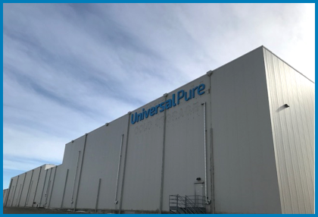
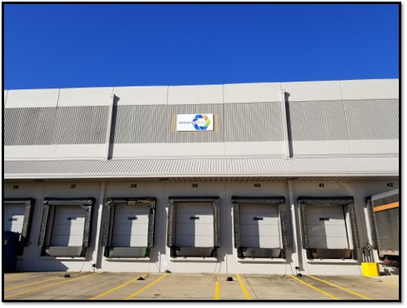
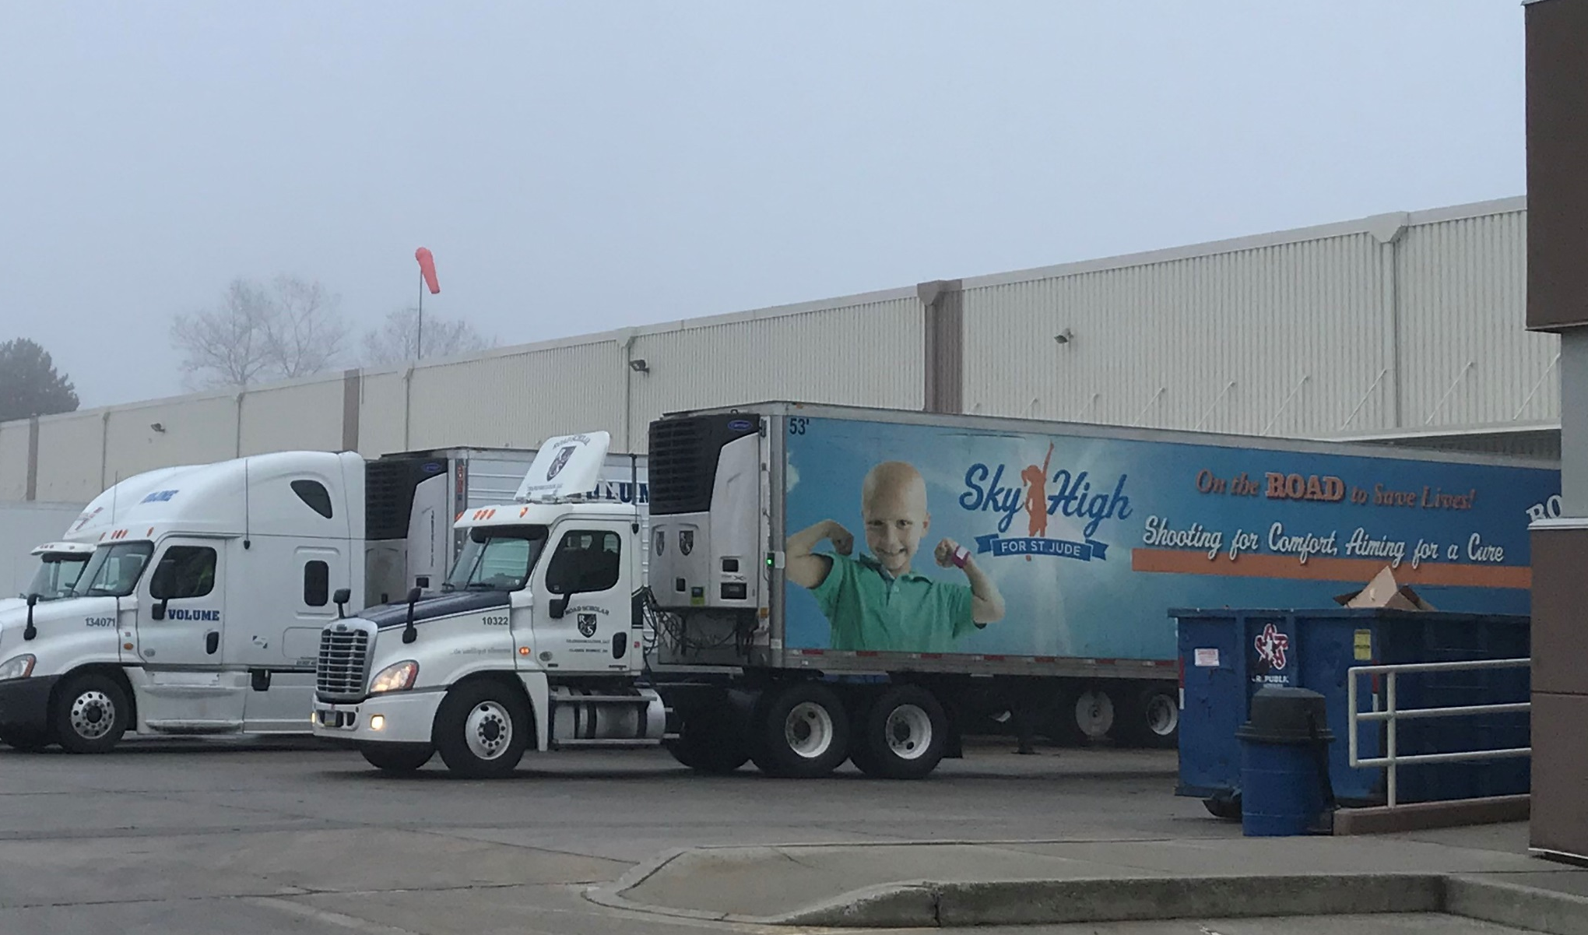
facilities
Locations | Lincoln, NE | Villa Rica, GA | Coppell, TX | Malvern, PA
Acq. / Opened | Opened in 2001 (2013 expansion) | Opened in 2014 | Acquired in 2014 | Opened in 2015
Lease Renewal | Lease expires 2032 Three 5-year options to renew | Lease expires 2033 | In process of extending lease to 2022 | Lease expires 2025 Three 5-year options to renew
Services | HPP Service Provider, Cold Storage, Value-Add Services | HPP Service Provider, Temp. Controlled Storage, Value-Add Services | HPP Service Provider, Temp. Controlled Storage, Value-Add Services | HPP Service Provider, Temp. Controlled Storage, Value-Add Services
HPP Machines | Four 350L HPP Presses | Three 350L HPP Presses | Two 350L HPP presses | Two 525L HPP Presses
Size | North: 370,000 sq. feet South: 270,000 sq. feet | 90,000 sq. feet | 24,000 sq. feet | 95,000 sq. feet Add’l. 75,000 sq. feet subleased
Other | 88 Dock Doors 90 Rolling Stock OSSID weigh-price-labelers for code dating and pre-pricing Kitting/Assembly Line Overwrap Capabilities Dry Age Rooms (4), Water & Air Tempering | 19 Dock Doors 4 Rolling Stock Ink Jet Capability Pack Off Line Scale System Labeling Air Tempering | 6 Dock Doors 3 Rolling Stock Ink Jet Capability Pack Off Line Sale System Labeling | 27 Dock Doors 5 Forklifts/Pallet Movers Ink Jet Capability Pack Off Capability Auto Labelers Front End Dumping & Scale System
13

Slide 14
facilities
Malvern, PA
Geographical Reach
Lincoln, NE
  With four strategically placed facilities, Universal Pure is able to serve a majority of the U.S. population
Villa Rica, GA
400-mile radius
Coppell, TX
  Key Business / Facility Highlights
  Employment: Universal Pure employs approximately 75 non-union, salaried employees and approximately 350 hourly/temp employees across all locations
  Redundancy: The company operates and services 11 HPP machines across 4 locations
  Facilities: Over 1 million square feet of HPP, cold storage, value added service and administrative space, with 12 million cubic feet of cold storage and freezer space
  Capacity: Available space across all locations for an additional 8 HPP machines, with 4 pads already poured
14

Slide 15



















AT A GLANCE
  Integrated offering
HPP
Cold storage
Logistics
Distribution
Blast Freeze
Tempering
Packaging
Kitting
  Broad geographical reach
NE
PA
GA
400-mile radius
TX
  Segment Leader
  Universal has 20%+ market share and is nearly 2x the size of its closest competitor*
  Blue chip customers
  *Management estimates based on capacity (liters) and estimated utilization for independent / outsourced providers.
15

Slide 16


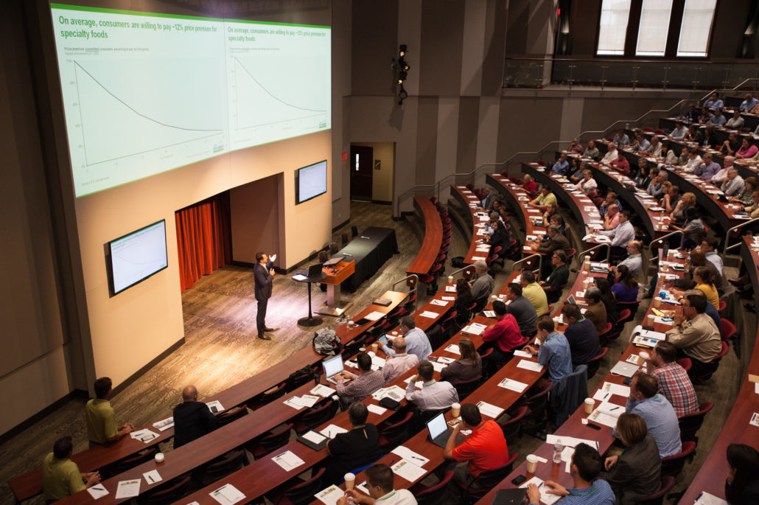

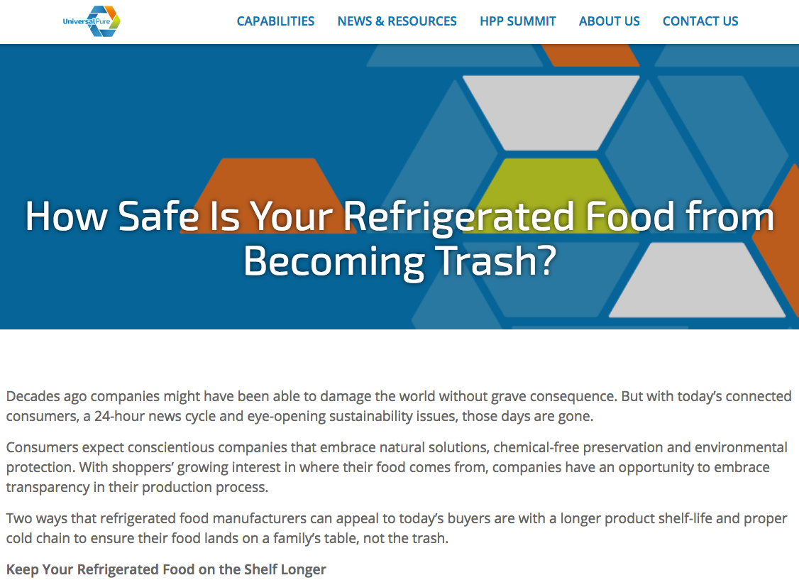
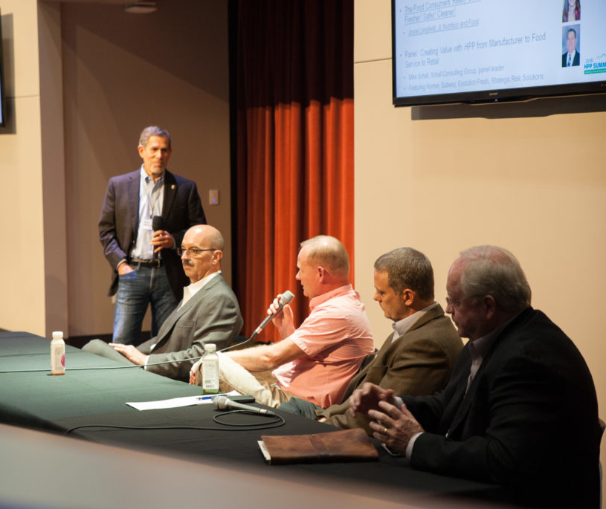

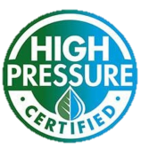
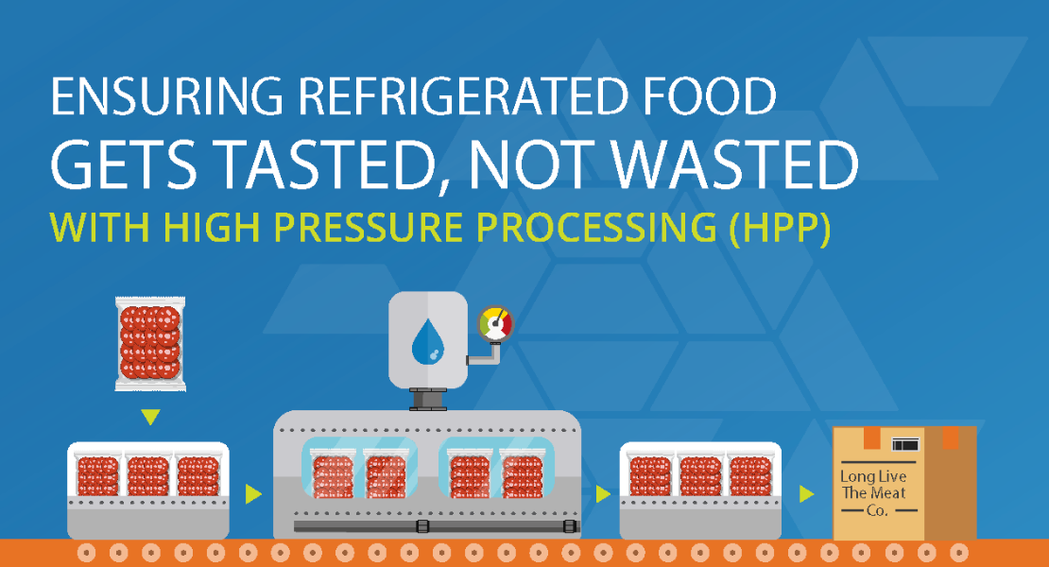

Industry leadership
HPP Summit™
Cold Pressure Council
Research & Resources
Annual conference hosted by Universal Pure
Founding member
Driving consumer & manufacturer awareness
“
To lead, facilitate and promote industry standardization, user education, and consumer awareness of High Pressure Processing
”
200
Attendees
25+
Expert Speakers
High Pressure Certified Consumer Seal Debuted in 2017
16

Slide 17
Service offerings
  Value-Added Offering, Pre- and Post-HPP
  Universal Pure has HPP capabilities across 4 facilities and 1 million square feet of cold storage space, providing the ability to handle HPP needs, cold storage & logistics
NE
PA
GA
400-mile radius
TX
Capabilities | UNIVERSAL PURE | Competitor A | Competitor B | Competitor C | Competitor D
Cold Storage
Blast / Room Freeze
Tempering
Kitting
R&D / Validation Assistance
Regulatory Assistance
Warehouse Mgt. System
Logistics Partner
  Unmatched Service Offerings
17

Slide 18



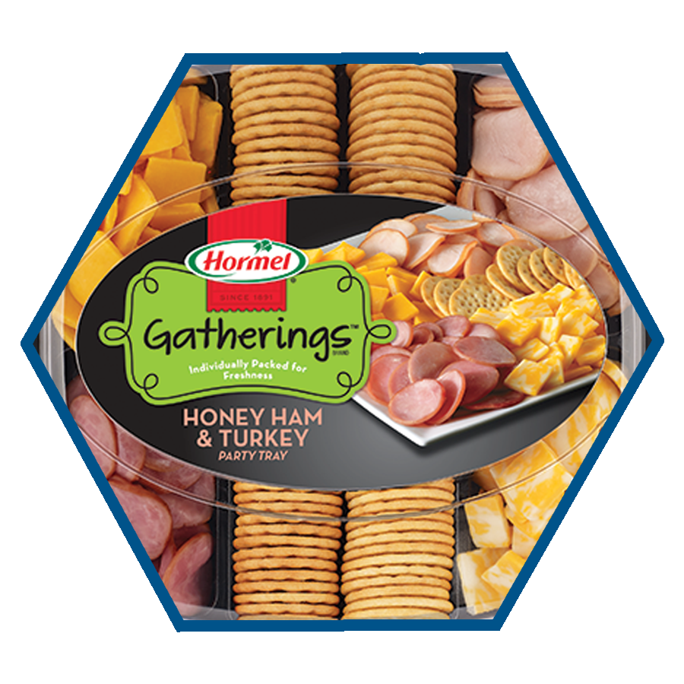
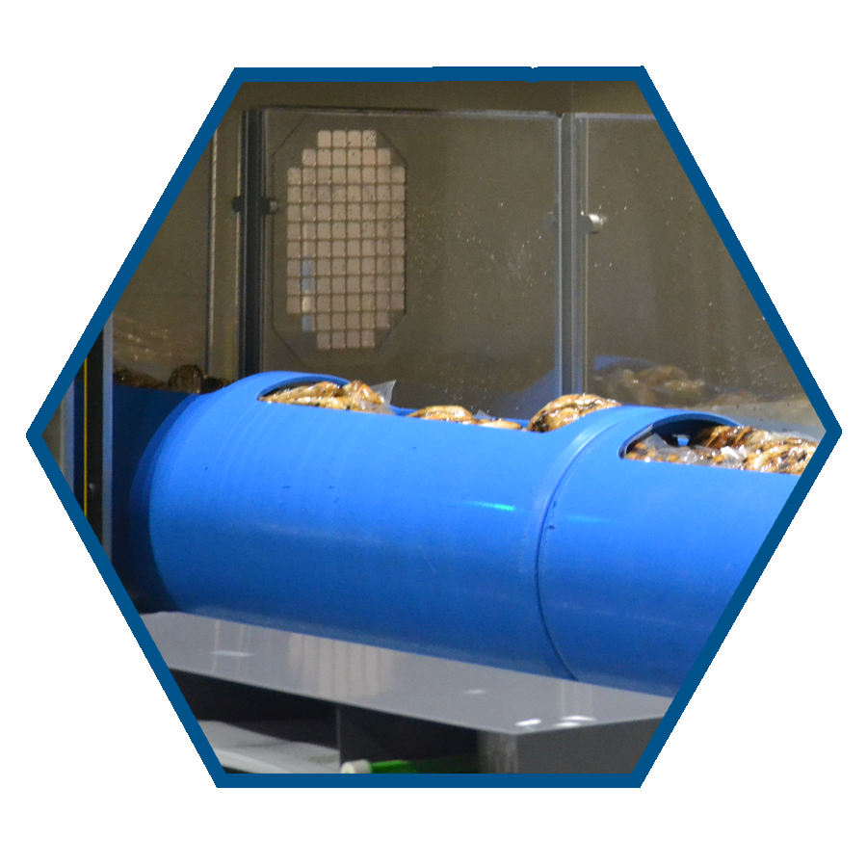

Service offerings
  Value-Add Capabilities & Services
    HPP
    Cold storage
    Dry aging
    Regulatory assistance
    Validation assistance
    Regulatory assistance
    Kitting
    Tempering
    R&D assistance
    Logistics
    Code / date stamping
    Co-packing relationships
  Full-Service Case Study: Hormel Snack Trays
  Given Universal Pure’s history of being a value added leader in HPP and cold storage, in 2017 the company developed a comprehensive bundled solution to include kitting and distribution logistics for snack trays
  Kit is packaged and distributed
  Kit is coded, dated & stamped
  Snack tray components arrive at Universal Pure facility
  Kit is assembled
  Sliced meats are HPP’d
18

Slide 19





Technical expertise
  In-house Technical Expertise & Engineering Capabilities
  Robust IT & Operational Systems
  Breadth
  Experience
  Cloud-based inventory control system
  Allows customers full traceability of their products and customization of their orders
  Enables high ROI through order accuracy, on-time shipping and labor efficiency
  Universal Pure leverages its 18 in-house engineers / technicians to be the most innovative, lowest cost HPP provider in the industry
  Vast knowledge of HPP applications
  Packaging / product customization and insights
  Multi-site footprint leverages best practices across network
    Deep equipment expertise to improve uptime and drive down cost per cycle
  Business analytics tool
  Drives operational
  insights and
  opportunities for
  improvement in
  operating costs
  Analyzes sales pricing information and margin analysis
  Quality Assurance
  Continuous Improvement
  Robust quality assurance:
    Validation study support for partners
    Internal tools for control points
    Knowledge of customer expectations
    Risk assessment & crisis control plan
    SQF Level III
  Focus on evaluating processes and determining solutions for continuous improvement:
    Operational equipment improvements – leveraging both Avure and Hiperbaric expertise
    HPP processing efficiencies
  An ERP solution improving understanding of financials, inventory and operations
  Largest CRM platform, offering cloud-based applications for sales, services and marketing
19

Slide 20









competition
HPP Service Provider Current Capacity Share
Others
4 facilities,
11 machines
  Universal Pure is nearly 2x the size of its closest competitor
2 facilities,
7 machines
2 facilities,
3 machines
2 facilities,
5 machines
1 facility,
3 machines
1 facility,
4 machines
20

Slide 21
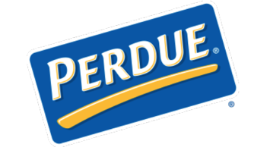





















CUSTOMERS
Dairy
Meat & Deli
Seafood
Breads
Non-Perishable Groceries
Frozen
Foods
Fruits &
Vegetables
Check Out
21

Slide 22


HPP OVERVIEW

Slide 23



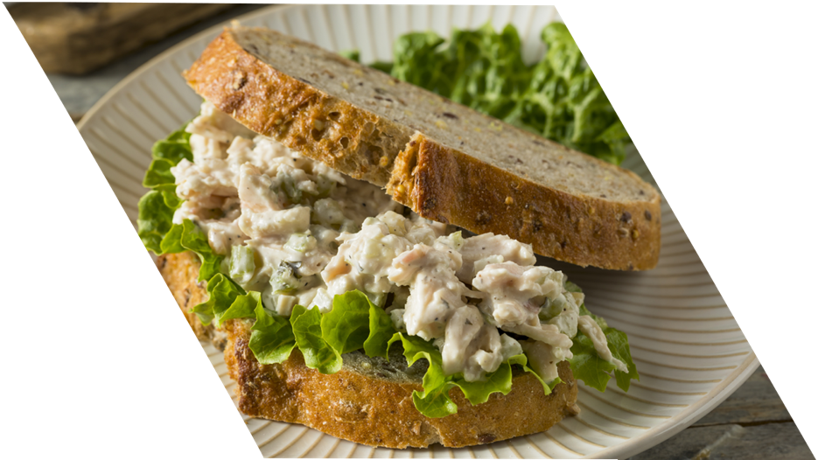
WHAT IS HPP?
High pressure processing (HPP) is a unique food processing method that utilizes water pressure to inactivate food-borne pathogens and spoilage organisms.
Unlike traditional thermal pasteurization methods
that can compromise flavor and nutrients,
HPP is a non-thermal process that:
  • Enhances food safety
  • Extends product shelf-life
  • Protects brand equity and
  company reputation
  • Enables the sale of cleaner label products
23

Slide 24
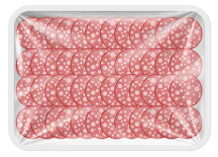
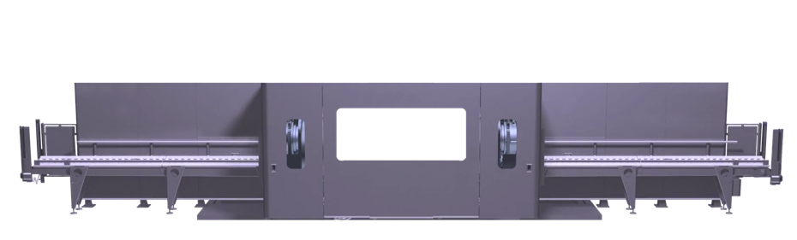
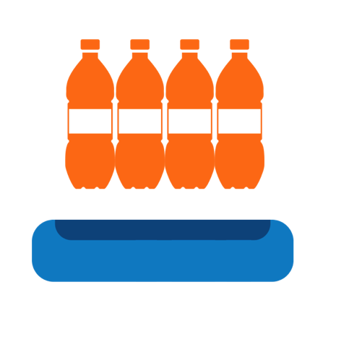
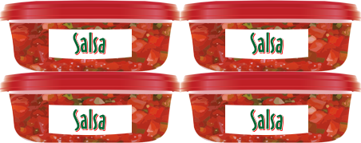





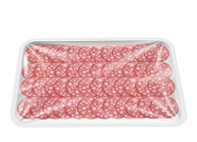



How hpp works
HOW HPP WORKS?
High pressure processing (HPP) is a unique food processing method that utilizes water and pressure to inactivate food-borne pathogens and spoilage organisms
Potable water is pumped into the vessel creating isostatic pressure on the packages.
Product is held at a pressure up to 87,000 psi for 1 to 6 minutes depending on the HPP process recipe.
CONVEYER
VESSEL
TO PACK OFF
Baskets are loaded with product in final packaging (hermetically sealed) and inserted into the HPP vessel. The basket enters
the vessel and is sealed by plugs.
Pressure is transmitted uniformly & instantaneously throughout the products
to disrupt microbial biochemistry of bacteria and spoilage microorganisms.
Product is scanned, code/date stamped, and prepared to be shipped to the customers.
24

Slide 25











HPP BENEFITS
Pathogen Reduction
Extended Shelf Life
Allows for Cleaner Label
Reduced Sodium Products
Creamier Consistency
PROTEINS
Sliced Cooked Meats, Uncured
Ham and Sausage, Pulled Chicken and Pork, Ground Meats
SEAFOOD
Oysters, Lobster, Crab,
Shrimp, Mussels
DAIRY
Yogurt & Yogurt based
dressings, Cream, Sour Cream, Cream Cheese, Milk
BEVERAGES
Orange Juice, Cold-Pressed
Juice, Coconut Water, Smoothies, Kale Drinks, Iced Coffee
WET SALADS / DIPS
Salsa, Chicken Salad,
Tuna Salad, Seafood Salad, Dressings
PET FOOD
Ground Meats such as
Turkey, Chicken, Beef
25

Slide 26

HPP TRENDS
CONSUMERS
Cleaner-label demands from concerned and better educated consumers
Explosive interest in fresh, more convenient, and less processed
foods / beverages
Consumer willingness to spend more money on wholesome foods
Consumers have more of an interest in production methods
than ever before
REGULATORY
Dramatic increase in customer audits to ensure compliance with new FSMA regulations
Increased focus from government after a large volume of product recalls in recent years
The need for formalized training of food safety and quality management
FOOD WASTE
The irrigated water used to grow
WASTED food is more than the water used by any country
Vegetables, Fruit, Meat, Dairy, and Seafood account for >50% food lost
Greater awareness to reduced food
waste with HPP’d products. Less food waste = reduced climate impact
Less food waste = reduced climate impact
26

Slide 27

HPP on the rise
In a survey of food and beverage producers:
59%
57%
respondents were familiar with HPP
characterized their companies’ use of the
technology as some growing or substantial
The most recognized Benefits of HPP were:
Pathogen
Reduction
Extended
Shelf Life
Leading HPP Foods Submarket
Shares Forecast (2016)
1%
3%
14%
28%
16%
27

Slide 28
Market trends
Global HPP & Cold Storage Market Analysis
The global HPP food market is projected to grow to $51.1B by 2027 (15.2% CAGR),
and the global cold storage market is anticipated to reach $213B by 2025 (12.4% CAGR)
Global HPP Food Market Forecast & Drivers (2017-2027)
Consumer preferences expanding perimeter of store
Sustainability & reduced waste
Demand for longer shelf life
“Clean label” trend
Market Size ($bn)
Increasing concern over food safety
28

Slide 29
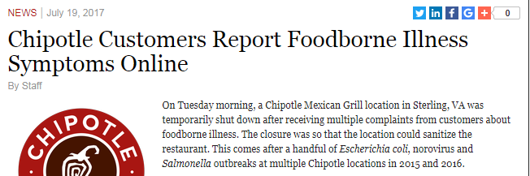

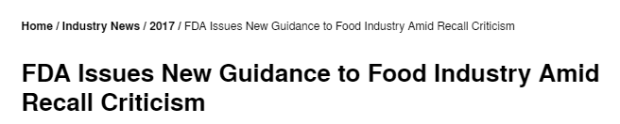

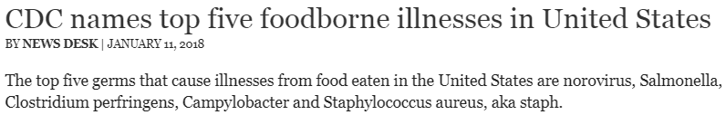
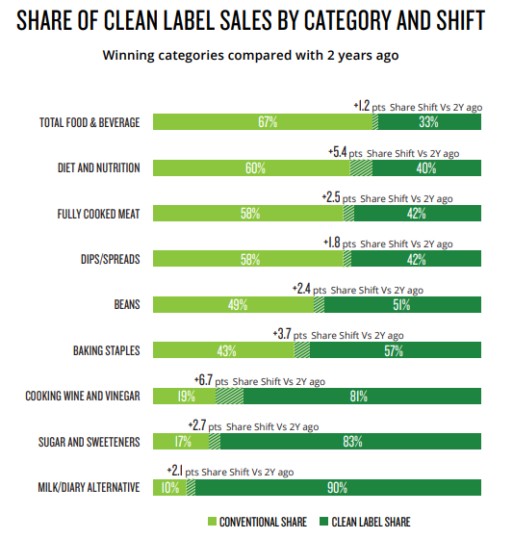

HPP TRENDS
Shelf Life Extension
Food Safety
Allows for broader distribution for HPP adopters
HPP reduces harmful bacteria like listeria, salmonella and e. coli
73.4%
Of producers say the biggest reason they use HPP is for shelf-life extension
of retailers say they are more likely to purchase a product with a longer shelf life
of food producers say they could expand distribution range if their products had a longer shelf life
96.2%
94.4%
Clean Label Trend
Sustainability / Reducing Food Waste
HPP eliminates need for artificial preservatives
HPP extends shelf life 2-10x, reducing waste
31%
Of food that is produced in America goes to waste (133 billion lbs. annually)
Tons of food produced for global consumption is lost or wasted
In annual lost retail sales in the U.S. is directly due to food waste
1.2B
~$160B
Consumers are moving away from center store aisles to purchasing fresh & refrigerated foods from the perimeter of the store
29

Slide 30
HPP industry trends
More HPP-Informed / Engaged Demographic
The percentage of respondents familiar with, and whose companies use HPP, grew from less than 60% in 2016 to the 80% range in 2017
HPP was favored by food service, manufacturers and retailers among other food processing methods on measures concerning food quality, food safety and food waste
HPP Wins Out
How did respondents characterize their use of HPP?
None: < 20%
Some: 23.5%
Substantial 32.3%
Growing: 25.4%
Growing use of HPP
How does this compare to 2016?
30

Slide 31

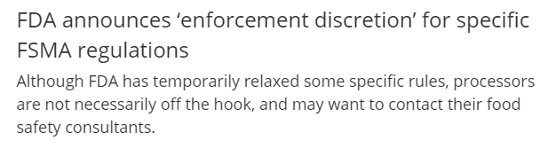


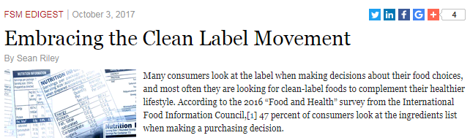


Trends
31

Slide 32

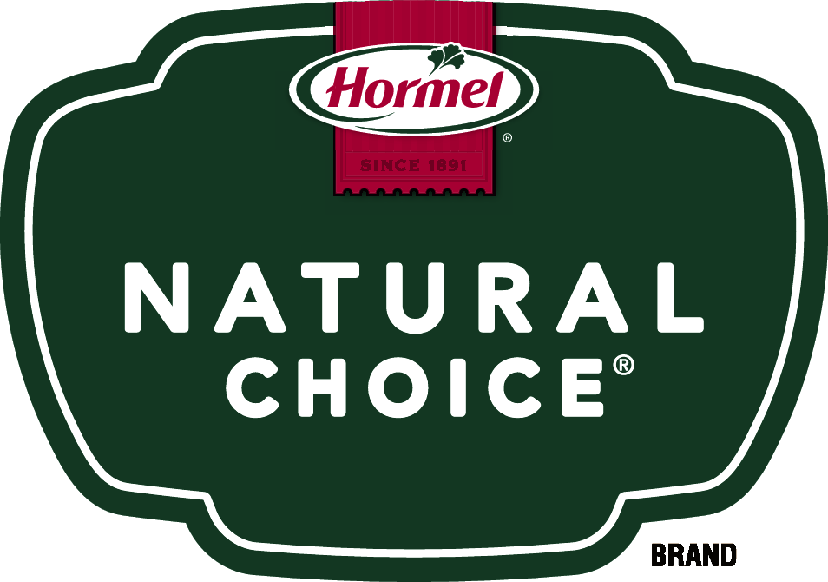
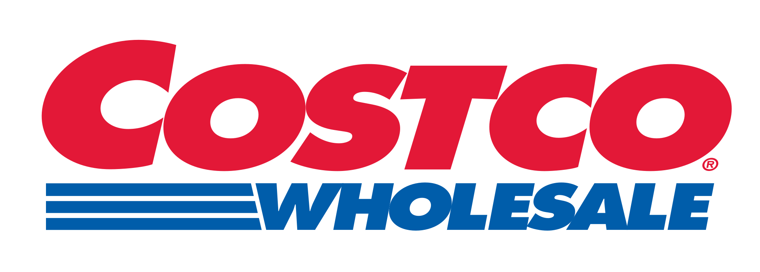






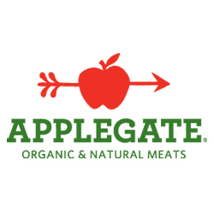


Hpp adoption
HPP trends and results have lead to widespread adoption
Potential Prospects
Why / Impact
  Meet the growing consumer demands for:
    Safer food & beverages
    Cleaner labels
    Corporate responsibility
  Shelf-life extension
  Brand equity protection
  Product innovation
  Food waste reduction
32

Slide 33








HPP Value CREATION
SAFER AND
HEALTHIER FOODS
ALIGNMENT WITH
CONSUMER INTERESTS
BRAND
PROTECTION
SAFER AND HEALTHIER FOOD AND BEVERAGES
COMPETITIVE
DIFFERENTIATION
IMPROVED SUSTAINABLITY/REDUCED FOOD WASTE
IMPROVED
INNOVATION
CHEMICAL FREE PRODUCTS
33

Slide 34

BENEFITS OF HPP
Enables
Food Safety
Delivers
Cleaner Labels
Extends
Shelf Life
WHY HPP?
Promotes
Sustainability
Enables Quality
Products
Provides Brand
Protection
34

Slide 35
HPP benefits
  Supports Shrink Control
  Extends Shelf Life
  Delivers Cleaner Labels
  Reduce store brand product shrink by 50%
  Positively impact inventory management in retail locations
  Increased supply chain efficiencies and cost avoidance
  Supports corporate sustainability & food waste initiatives
  HPP extends shelf-life 2X - 10X
  Category Non-HPP Shelf-Life HPP Shelf-Life
  RTE Meat 50 Days 100+ Days
  Fresh Protein 18-21 Days 36-50 Days
  Wet Salads 20-30 Days 50-60 Days
  Fresh Juice 3-6 Days 30-60 Days
  Dips Varies 2X to 5X
  Salsa Varies up to 10X
  Eliminate preservatives from store brands
  Appeal to growing consumer demands/expectations
  ‘Free From’ = shorter ingredient deck
  Reduced sodium
  HPP is a natural process
  Ensures Food Safety & Quality
  Protect brand equity
  Keep customers safe
  Reduce media headline risk
  Regulatory compliance
  Inactivates Pathogenic Vegetative Bacteria:
  Salmonella
  E. coli 0157:H7
  Listeria Monocytogenes (Lm)
  Campylobacter
  Vibrio & Viruses In Shellfish
  Kills Spoilage Organisms
  Fungi: Yeasts & Mold
  Inactivates Harmful Bacteria & Food Spoilage Microorganisms:
  Disrupting Their Microbial Biochemistry
35

Slide 36



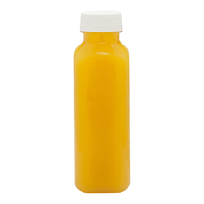
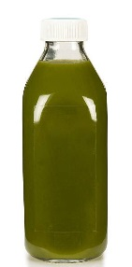
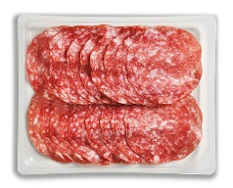
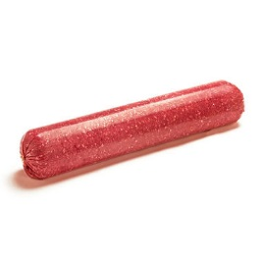
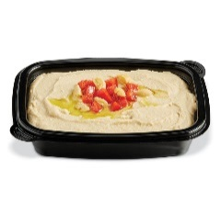
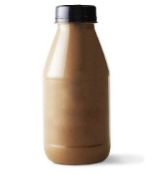
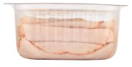
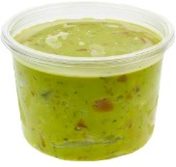
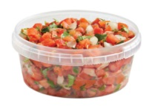






HPP applications / opportunities
PROTEINS
WET SALADS, DIPS, SALSA
BEVERAGES
Applications: Sliced Cooked Meats: Chicken, Turkey, Ham and Beef; Uncured Ham and Sausage; Pulled Chicken and Pork, Ground Meats such as Turkey, Chicken and Beef
Applications: Salsa, Chicken Salad, Hummus, Tuna Salad, Seafood Salad, Dressings
Applications: Orange Juice, Cold-Pressed Juice, Coconut Water, Smoothies, Kale Drinks, Iced Coffee
Select Brands & Retailers that Leverage HPP
Other Product Categories | Applications | Benefits
Dairy | Yogurt & Yogurt Based Dressings, Cream, Sour Cream, Cream Cheese, Milk
Seafood | Oysters, Lobster, Crab, Shrimp, Mussels
Fruits & Vegetables | Smoothies, Fruit Cups, Spreads
Pet Food | Ground Meats such as Turkey, Chicken, Beef
HPP Benefits Key:
Pathogen
Reduction
Extended
Shelf Life
Allows for
Cleaner Label
Reduced
Sodium Products
Creamier
Consistency
36

Slide 37



BENEFITS OF OUTSOURCING
1.
NO CAPITAL INVESTMENT
Third-party HPP processing allows you the freedom to adjust product Capacity and frequency at any time without a huge capital investment.
2.
QUICK STARTUP &
ONGOING FLEXIBILITY
Get your HPP operation up and
running as fast as possible – we are ready when you are.
3.
COST MANAGEMENT
Along with labor, insurance fees and other operating expenses, companies that outsource mitigate the risk of inconsistency in forecasted costs vs. actual costs.
4.
REDUNDANCY
(GUARANTEED AVAILABILITY)
Downtime means lost revenue, which is why outsourcing
to Universal can support
your production scheduling efficiency targets.
5.
VALUE ADDED SERVICES
Pre-HPP and Post-HPP services that can drive additional value for your company (Cold Storage, Tempering, Labeling, etc.).
6.
FOCUS ON CORE COMPETENCY
Focus on your core competencies while the experts at Universal reliably take care of your HPP operation
37

Slide 38


SUMMARY
High Pressure Processing can help companies provide safe foods & beverages, high quality products and leverage and innovation to meet customer/consumer needs and expectations.
38

Slide 39

CHANNEL AUDIENCES

Slide 40


MANUFACTURERS
40

Slide 41


RETAIL
41

Slide 42

FOOD SERVICE
42

Slide 43

Pet food
43

Slide 44

SOLUTIONS

Slide 45

NEW CUSTOMER
45

Slide 46

NEW PACKAGING
46

Slide 47

MISCELLANEOUS

Slide 48



Business Alignment
…responsibly producing safe, high quality food…
We help ensure the safety of the foods and beverages our children consume…
our greater cause
…responsibly helping customers prosper with flexible, forward-thinking solutions…
As a third-party service provider, we feel it is our responsibility to help our customers focus on what matters most to their business
…being a responsible employer, investing in our associates…
HPP
Always looking ahead to advance the safety and quality of what we eat and drink is the contribution to the world we take very seriously
…being responsible members of the communities…
We know we can help companies have a material impact on reducing food waste
…being responsible stewards of the natural resources we utilize…
48

Slide 49


OUTSOURCE VS
IN-HOUSE HPP?
What’s the best decision for your company?
Does in-house HPP give
us more control and
flexibility?
How can outsourcing HPP help Perdue avoid business challenges and complexities while saving on CapEx?
Does in-house HPP help lower our costs?
Does in-house HPP help
lower our costs?
Outsourcing
In-House
…being responsible stewards of the natural resources we utilize…
49

Slide 50


KEY FACTORS
Core Business
Focus
Capital Expenditures &
Operating Expenses
Production
Line Efficiency
Impacts
LEARNING
CURVE
Ramp-Up & Down
Speed & Flexibility
Required
Engineering
Expertise
50

Slide 51
CAPITAL EXPENDITURE & OPERATING EXPENSES
Capex | Industry Average | Comments
HPP Machine (525-L) | $3MM - $3.5MM | Recommended that each machine has a back-up, so customer commitments are not compromised
Front & Back End Ancillary Equipment | $400K-$500K | Inkjet, scales, hopper, drying system, conveyors, tape machines, carriers, etc.
Retrofit | $250K-$750K* | Concrete pad, water, drains, electricity
Can a HIGHER RETURN on capital be ACHIEVED by investing in your CORE BUSINESS, such as R&D / Innovation, Sales and/or Marketing?
*If the infrastructure already exists.
OpEx | Industry Average | Comments
Operating staff | 7-9 line workers, 1 material handler, 1 QA technician, 1 supervisor | Per shift
Maintenance staff | 1 maintenance engineer ~$100K (fully burdened) | Per Shift
Parts | ~$6.50 per cycle | Not including spare parts inventory
Spare parts inventory | $150K | Not including spare vessel ($600,000)
Maintenance downtime | 8-12% | Not including unscheduled downtime
Utilization | TBD | 20-30 MM lbs. of product required to achieve full utilization
Other costs | Site specific | Utilities, CIP, ink jet, labeling, HPP audits / compliance, rent/space for equipment and product storage
51

Slide 52




CORE BUSINESS FOCUS
Is in-house HPP a distraction today?
Could outsourcing HPP free up space and labor for further production initiatives?
Does saving on CapEx allow for further marketing and R&D exploration?
QUALITY & SAFETY?
INNOVATIVE THINKING
HPP
CUSTOMIZED SOLUTIONS
52

Slide 53



How can we help you make the
best decision for your company?
NEXT STEPS
What next steps
would you like us
to take?
Which of the
"Key Factors
to Consider”
do you feel will
be the most
challenging?
What else can
we do to help
you make this
decision?
53

Slide 54




Next steps
We welcome your guidance to understand the strategies and objectives for your stores
We want to discuss what types of products you are interested in developing with our assistance. How can incorporating HPP positively impact your profitability, products and brand objectives?
We hope to schedule follow-up meetings to further explore the potential for a mutually beneficial strategic partnership
Our ultimate goal is to XXX
54

Slide 55
KEY INITIATIVES
    2018 KEY INITIATIVE
Sales enablement
LEAD GENERATION
RESULTS
LEADERSHIP POSITIONING
& MESSAGING
Salesforce training
Salesforce optimization
Value proposition templates
Lead management process
Create sales dashboards
Build lead nurturing campaigns
Execute cross channel lead
generation campaigns
Generate consistent inbound leads
Establish KPI’s
Speaking engagements at industry events
Thought leadership content
HPP Summit
Cold Pressure Council
Engage with trade associations
and groups
Efficiency Revenue Impact
Execution Goals:
Team training by 2/28/18
Create dashboards by 3/31/18
Sustainability & Brand
protection template
Revenue Impact
Execution Goals:
$1.5MM marketing sourced pipeline
Customer Value Revenue Impact
Execution Goals:
4 speaking engagements
4 whitepapers or research reports
55

Slide 56

KEY TRENDS
Food Safety
Reduce Product Contamination
5 Log Reduction
Reduce Risk of Recall
Regulatory Compliance
Good Name & Reputation (Company, Brand)
Cleaner Labels
Consumer Expectations
New Product Development
Enhance Business with Consumer Connection
Healthy
Quality
Nutritional Value
Flavor
Sustainability
Shelf-Life Extension
Direct to Customer
Retail
Foodservice
Export Opportunities
Fresh vs. Frozen
Food Waste Reduction
Packaging Innovation
56

Slide 57
HOW UNIVERSAL PURE CAN SUPPORT YOU
Universal Pure can work with your co-manufacturing partners or bring our relationships to help you innovate and deliver the best products to your customers
Malvern, PA
Lincoln, NE
6
2
10
5
3
20
15
17
Juice & Dairy:
United Juice Companies of America
Harvest Soul
Juice From the Raw
BGC Manufacturing
2
5
9
3
3
5
15
7
10
7
8
6
4
8
1
16
3
14
13
Meat:
Continental Sausage
Maryanns Specialty Foods
West Liberty Foods
WG Provisions
Wolverine Packing
American Foods Group
Crystal Lake Foods
Glenn Valley Foods
Gourmet Boutique
Mosner Family Brands
House of Raeford
Villari Foods Group
American Foods Group
Sugar Creek
Berk’s Packing Company
John F Martin and Sons
Blount Seafood Corp
Deen Meats Co.
Bally's Plus Foods
American Foods Group
1
4
6
2
8
11
7
9
4
1
12
1
1
10
2
2
12
11
9
4
Soups, Sauces, & Dressings:
Calpack Foods
Faribault Foods, Inc
Parkers Farm
Bakkavor
Summer Garden Food Mfg.
Chairmans Foods
Knotts Food
House of Thaller
Bally's Plus Foods
Bartush Foods
Classic Foods
Frankie V's Kitchen
Hill Country Foodworks
Heritage Family Foods
Giraffe Foods (Canada)
18
14
19
Villa Rica, GA
Packaging:
Printpack Inc.
Winpak Films Inc.
Teinnovations LLC
Berry Plastics Corp.
EasyPak/Tray-Pak
Kapak
Comar
GK Packaging
Cryovac Sealed Air Corp.
Curwood Inc.
13
1
Fruits & Vegetables:
1. Summer Garden Food Mfg.
Coppell, TX
Ready Meals & Wet Salads:
Vanguard Foods
Chairman's Foods
57

Slide 58
Universal pure network of supplier partners
  Pre-HPP, HPP and Post-HPP Value-Added Services & Logistics
  Universal Pure has deep relationships with co-packers and other strategic partners to provide an integrated, customized service to each customer
  CANADA
  Co-Packer Network
Meat
Soups, Sauces, & Dressings
Juice & Dairy
Fruits & Vegetables
Ready Meals & Wet Salads
4
  Other Strategic Partners
Packaging
Product Development
Laboratories
Academia
58

Slide 59






HOW UNIVERSAL PURE CAN SUPPORT YOU
Partner with Universal to Deliver Your HPP Needs:
Ensures
Food Safety
Delivers
Cleaner Labels
Extends Product Shelf Life
Increases Sourcing Potential of Cleaner Label “Free From” SKU’s
Enhances Food Safety & Increases Brand Protection
Supports Achievement of Food Waste & Sustainability Goals
Leverage Your Existing Supplier & Manufacturer Network
Leverage Universal Pure’s Network of Supplier Partners
Extends
Shelf Life
Promotes
Sustainability
Enables Quality
Products
Provides Brand
Protection
59

Slide 60

OUR MANIFESTO
Our work is bigger than a process or a procedure.
Because what we do affects families.
Here, we’re universally committed to a greater cause:
Making sure every bit and every sip is not only fresh and delicious, but, most importantly, safe.
We have zero tolerance for uncertainty.
We eliminate the “what ifs” with action that earns trust.
We’re always on the forefront of what’s next,
Giving our food and beverage partners the freedom to pursue and reach their business goals.
This is absolute confidence.
This is peach of mind.
This is Universal Pure.
Where each one of us is purely driven to be our very best.
60

Slide 61







COMPANY VALUES
We CARE about YOU
Universal Pure is built on care. You can see it in our safety programs,
employee training, recognitions, rewards and our relationships with
employees, customers, suppliers, business partners and community members
Reliable SERVICE is our responsibility
We stay flexible to meet the changing marketplace conditions and keep the
customer at the center of everything we do – earning trust through
reliable service, over time
We COLLABORATE to get BETTER
At Universal Pure, we advance by working together, collaborating and cooperating through teamwork and partnerships to drive continuous improvement
We DO what we SAY with INTEGRITY
Universal Pure is dedicated to integrity, trust and open communications.
We accept responsibility and follow through on our commitments
RESULTS matter
Proven and re-proven each day, our focus on results shines bright in terms
of the value we create for our customers – operations efficiencies, sales,
sustainability efforts and more
61

Slide 62










HPP industry trends
“The formation of the Cold Pressure Council demonstrates the remarkable growth of HPP”
Founding Members
To lead, facilitate and promote industry standardization, user education, and consumer awareness of High Pressure Processing
High Pressure Certified Consumer Seal to Debut
62

